Slide 1
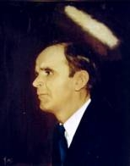

117
IT SHALL FLOW LIKE A RIVER
It shall flow like a river, It shall fall like the rain,
It shall rise as the dew in morning o’er the plain;
For the knowledge of the Lord shall fill all the earth
When the Spirit of the Lord shall fall.

Slide 2
Flow, river, flow; flow, river, flow;
Flow out through the nations wherever man may go;
Cause life to spring forth, that all men may know
That you’re the river of the Spirit;
Oh, flow, river, flow.

